Slide 1
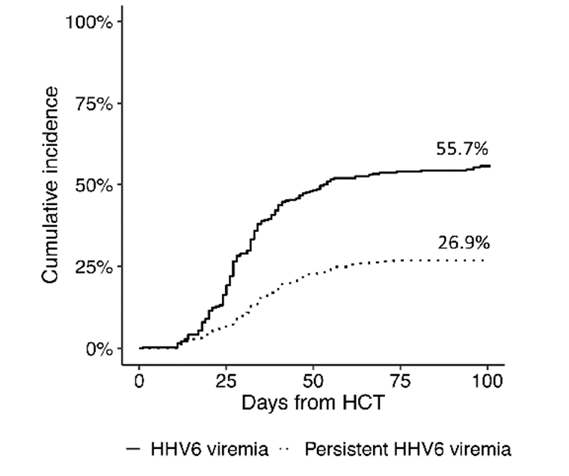
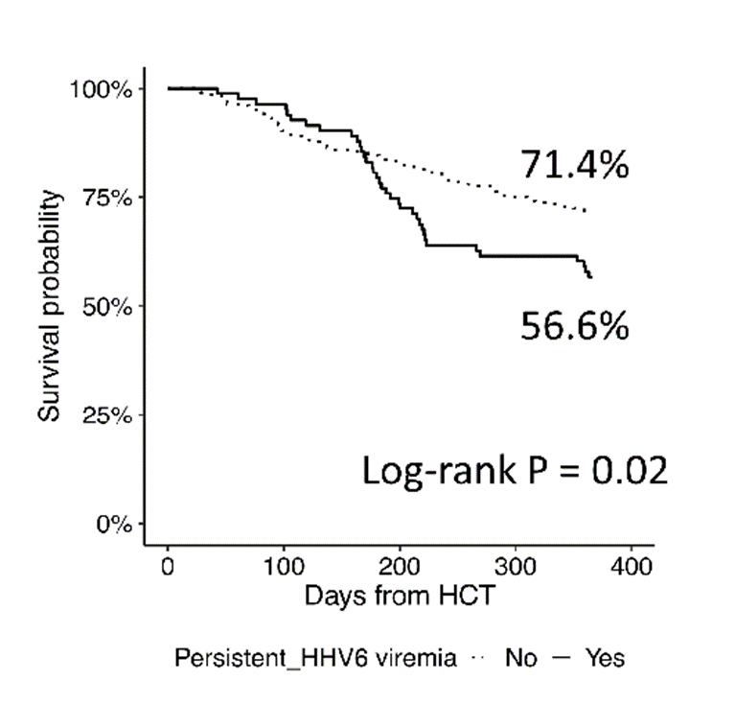
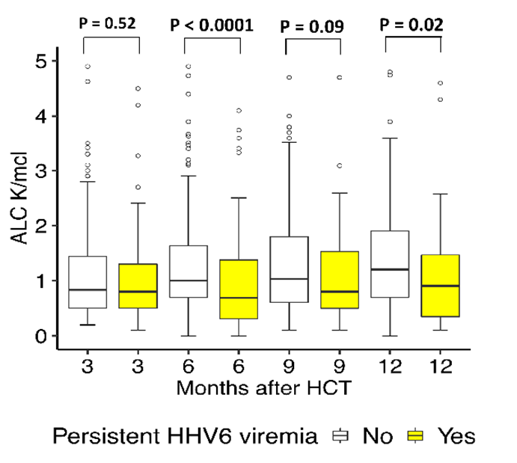
The impact of HHV-6 in recipients of ex vivo T-cell depleted hematopoietic cell transplant
Yeon Joo Lee, MD, MPH^{1, 3}, Yiqi Su, MS¹, Roni Tamari, MD^{2, 3}, Ann A Jakubowski, MD, PhD^{2, 3}, Sergio A Giralt, MD,^{2, 3},
Genovefa A Papanicolaou, MD^{1, 3}
Poster number: 519
¹Infectious Diseases Service, ²Adult Bone Marrow Transplantation Service, Department of Medicine, Memorial Sloan Kettering Cancer Center, New York, NY, ³Weill Cornell Medical College, Cornell University, New York, NY
Introduction
27% TCD HCT developed persistent HHV-6 viremia
Persistent HHV-6 viremia was associated with decreased survival
HHV-6 viremia is associated with graft-versus-host disease (GVHD), cytopenia, and encephalitis after hematopoietic cell transplant (HCT).
Recipients of ex vivo T-cell depleted (TCD) (CD34⁺ selected) HCT are at increased risk for viral infections. Since 2012, TCD HCT recipients at MSKCC were prospectively monitored for HHV-6 viremia.
The objectives of our study were to
identify risk factors of persistent HHV-6 viremia.
examine the impact of persistent HHV-6 viremia on lymphocyte recovery.
examine the impact of persistent HHV-6 viremia on survival.
HHV-6 disease: 7 patients (8% with persistent HHV-6 viremia)
Encephalitis: 1
Pneumonitis: 4
Organizing pneumonia: 2
HHV-6 viremia
Persistent HHV-6 viremia
Mismatched donor and CMV R- were predictors of persistent HHV-6 viremia in MV Cox model
Methods
Conclusions
P=0.04
Recipients with TCD HCT between 2012 and 2016 at MSKCC.
CD34⁺ selection was performed by the CliniMACS CD34 Reagent system (Miltenyi Biotec, Germany).
Routine monitoring for HHV-6 by quantitative PCR in plasma started on day+14 post-HCT (D+14) and through D+100.
HHV-6 viremia was defined as ≥1 HHV-6 viral load >limit of quantification.
Persistent HHV-6 viremia was defined as ≥2 consecutive viral loads ≥500 copies/mL.
Cox proportional model was used to examine the risk factors
of persistent HHV-6 viremia and 1-year overall survival was
estimated by Kaplan-Meier method.
P=0.04
27% of TCD HCT recipients developed persistent HHV-6 viremia.
Mismatched donor and CMV R- were predictors for persistent HHV-6 viremia in MV Cox models (P=0.04 for both).
8% of patients with persistent HHV-6 viremia developed HHV-6 end-organ disease.
Patients with persistent HHV-6 viremia had lower ALC and lower overall survival at 1-year post-HCT compared with patients without persistent HHV6 viremia (P=0.02 for both).
Age, sex, underlying diseases, total body irradiation, donor type, recipient CMV serology, and GVHD were evaluated in the Cox proportional model. Significant results are shown.
Patients with persistent HHV-6 viremia had lower absolute lymphocyte count (ALC) at 1 year post-HCT
Baseline characteristics
Characteristics |  | N (%) = 312 (%)
Age | Median (range) | 54.8 (21.7 – 73.3)
Sex | Male | 183 (59%)
Donor | Matched | 158 (83%)
CMV serology | R+ | 184 (59%)
 | R- | 128 (41%)
Acute GVHD | 2-4 | 54 (17%)
Corresponding author: Genovefa Papanicolaou
papanicg@mskcc.org
1275 York Ave, Box 9, New York, NY 10065
Funded in part through the NIH/NCI Cancer Center Support Grant P30 CA008748.
Underlying diseases: acute leukemia/myelodysplastic syndrome 210 (67%), multiple myeloma 75 (24%), myeloproliferative disorder 24 (8%), nonhematologic malignancies 3 (1%)

